Slide 1
Constitutional Convention
Ch 3.1 and 3.2

Slide 2
In 1787, a remarkable group of American leaders, from all but one state, gathered in Philadelphia to address the weaknesses of the Articles of Confederation, but they soon decided that a new Constitution was needed.
Delegates to the Constitutional Convention arrived with varying ideas and plans of government, which meant that Compromise would be necessary to reach an agreement

Slide 3
The Road to the Constitution
Constitutional Convention:
  The Constitutional Convention was held in 1787
  The Convention was held in Philadelphia’s Independence Hall
  The purpose of the Convention was to fix the flaws of the Articles of Confederation
  There was 55 delegates from all but one state
    Rhode Island did not send any delegates to the Convention because they were opposed to a stronger, central government
  Women, Native Americans, and African Americans were excluded from the Convention

Slide 4

The Road to the Constitution
Operating Procedures:
  George Washington presided over the Constitutional Convention
  Delegates from at least 7 states must be present to take a vote
  Must have majority vote, with each state having one vote, for approval of any changes
  All discussions were held in private

Slide 5
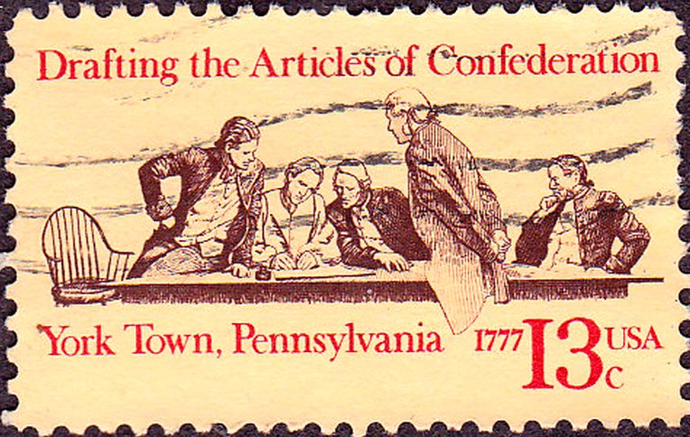
The Road to the Constitution
End Result of the Convention:
  Discarded the Articles of Confederation
  Wrote a new Constitution

Slide 6
Creating and Ratifying the Constitution
  Virginia Plan
    Created by James Madison
    Called for 3 branches of government
      Legislative Branch
      Executive Branch
      Judicial Branch
    Legislature:
      Divided into 2 houses, with Representation based on population
    States that opposed the Virginia Plan: Small States
      Feared larger states would ignore the interest of small states

Slide 7
Creating and Ratifying the Constitution
New Jersey Plan
  Proposed by William Paterson
  Also called for 3 branches of government
  Legislature:
    Only one house, where each state gets 1 vote
  States that opposed the New Jersey Plan: Large States
    Larger states thought that they should have more power

Slide 8
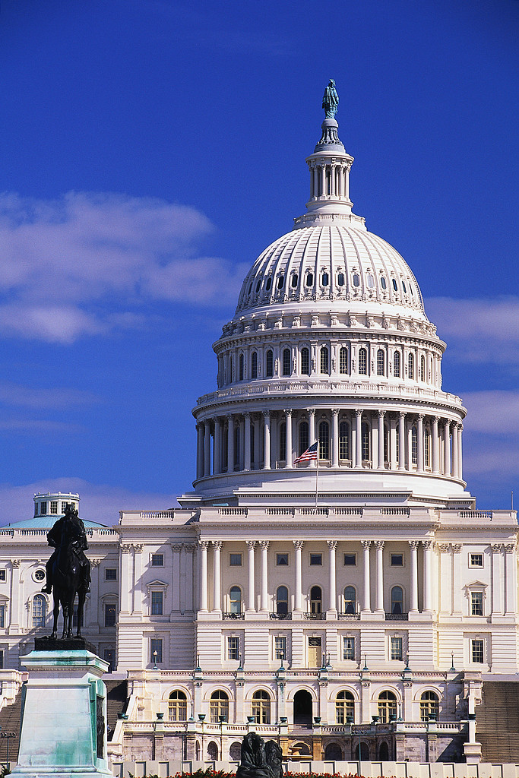
Compromises
Great Compromise
  Headed by Roger Sherman
  Proposed Compromise:
    Combination of Virginia Plan and New Jersey Plan
    Congress: divided into 2 Houses
      Senate: Equal representation for each state
      House of Representatives: Representation based on population

Slide 9
Compromises
Three-Fifths Compromise:
  South: wanted to count 550,000, mostly enslaved, African-Americans as part of their population
  North: opposed counting African-Americans in population because they were not allowed to vote or participate in government
  Compromise: every 5 enslaved persons would count as 3 free persons
    3/5 of slave population would determine representation in Congress and for tax purposes

Slide 10
Compromises
South agreed to allow Congress to regulate trade between states
North agreed that Congress could not tax exports or interfere with slave trade before 1808
Electoral College:
  Some wanted Congress to choose the President
  Others wanted the people to vote on the President
  Compromise: group of people named by each state legislature to select the President and Vice President
    The Electoral College in Present day: voters choose the members not legislatures

Slide 11
Approving the Constitution
After the Convention, a Constitution had been written, but 9 (nine) of 13 states had to ratify the Constitution before it could become the supreme law of the land

Slide 12
Approving the Constitution
Federalists: supporters of the Constitution
  Agreed with system of federalism – government divided between the federal and state governments
  Notable Federalists:
    Alexander Hamilton
    James Madison
    John Jay

Slide 13
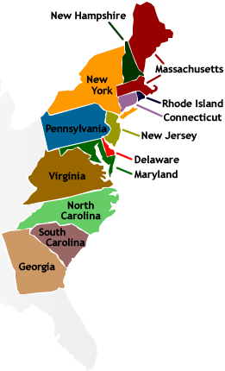
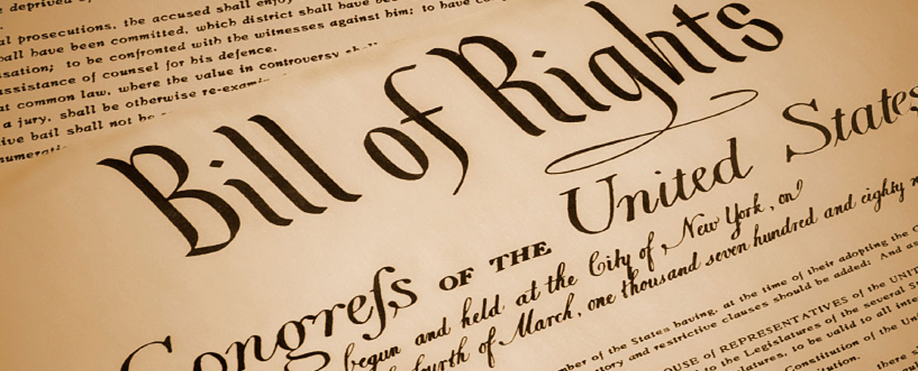
Approving the Constitution
Anti – Federalists: opposed the Constitution
  Worried that federal system took too much power away from the states
  Wanted a Bill of Rights included that would guarantee individual liberties

Slide 14
Approving the Constitution
Compromise between the Federalists and Anti-Federalists:
  If Constitution was adopted, the new government would add a Bill of Rights
  On June 21, 1788, New Hampshire became the ninth state to ratify the document, and it was subsequently agreed that government under the U.S. Constitution would begin on March 4, 1789.

